Slide 1
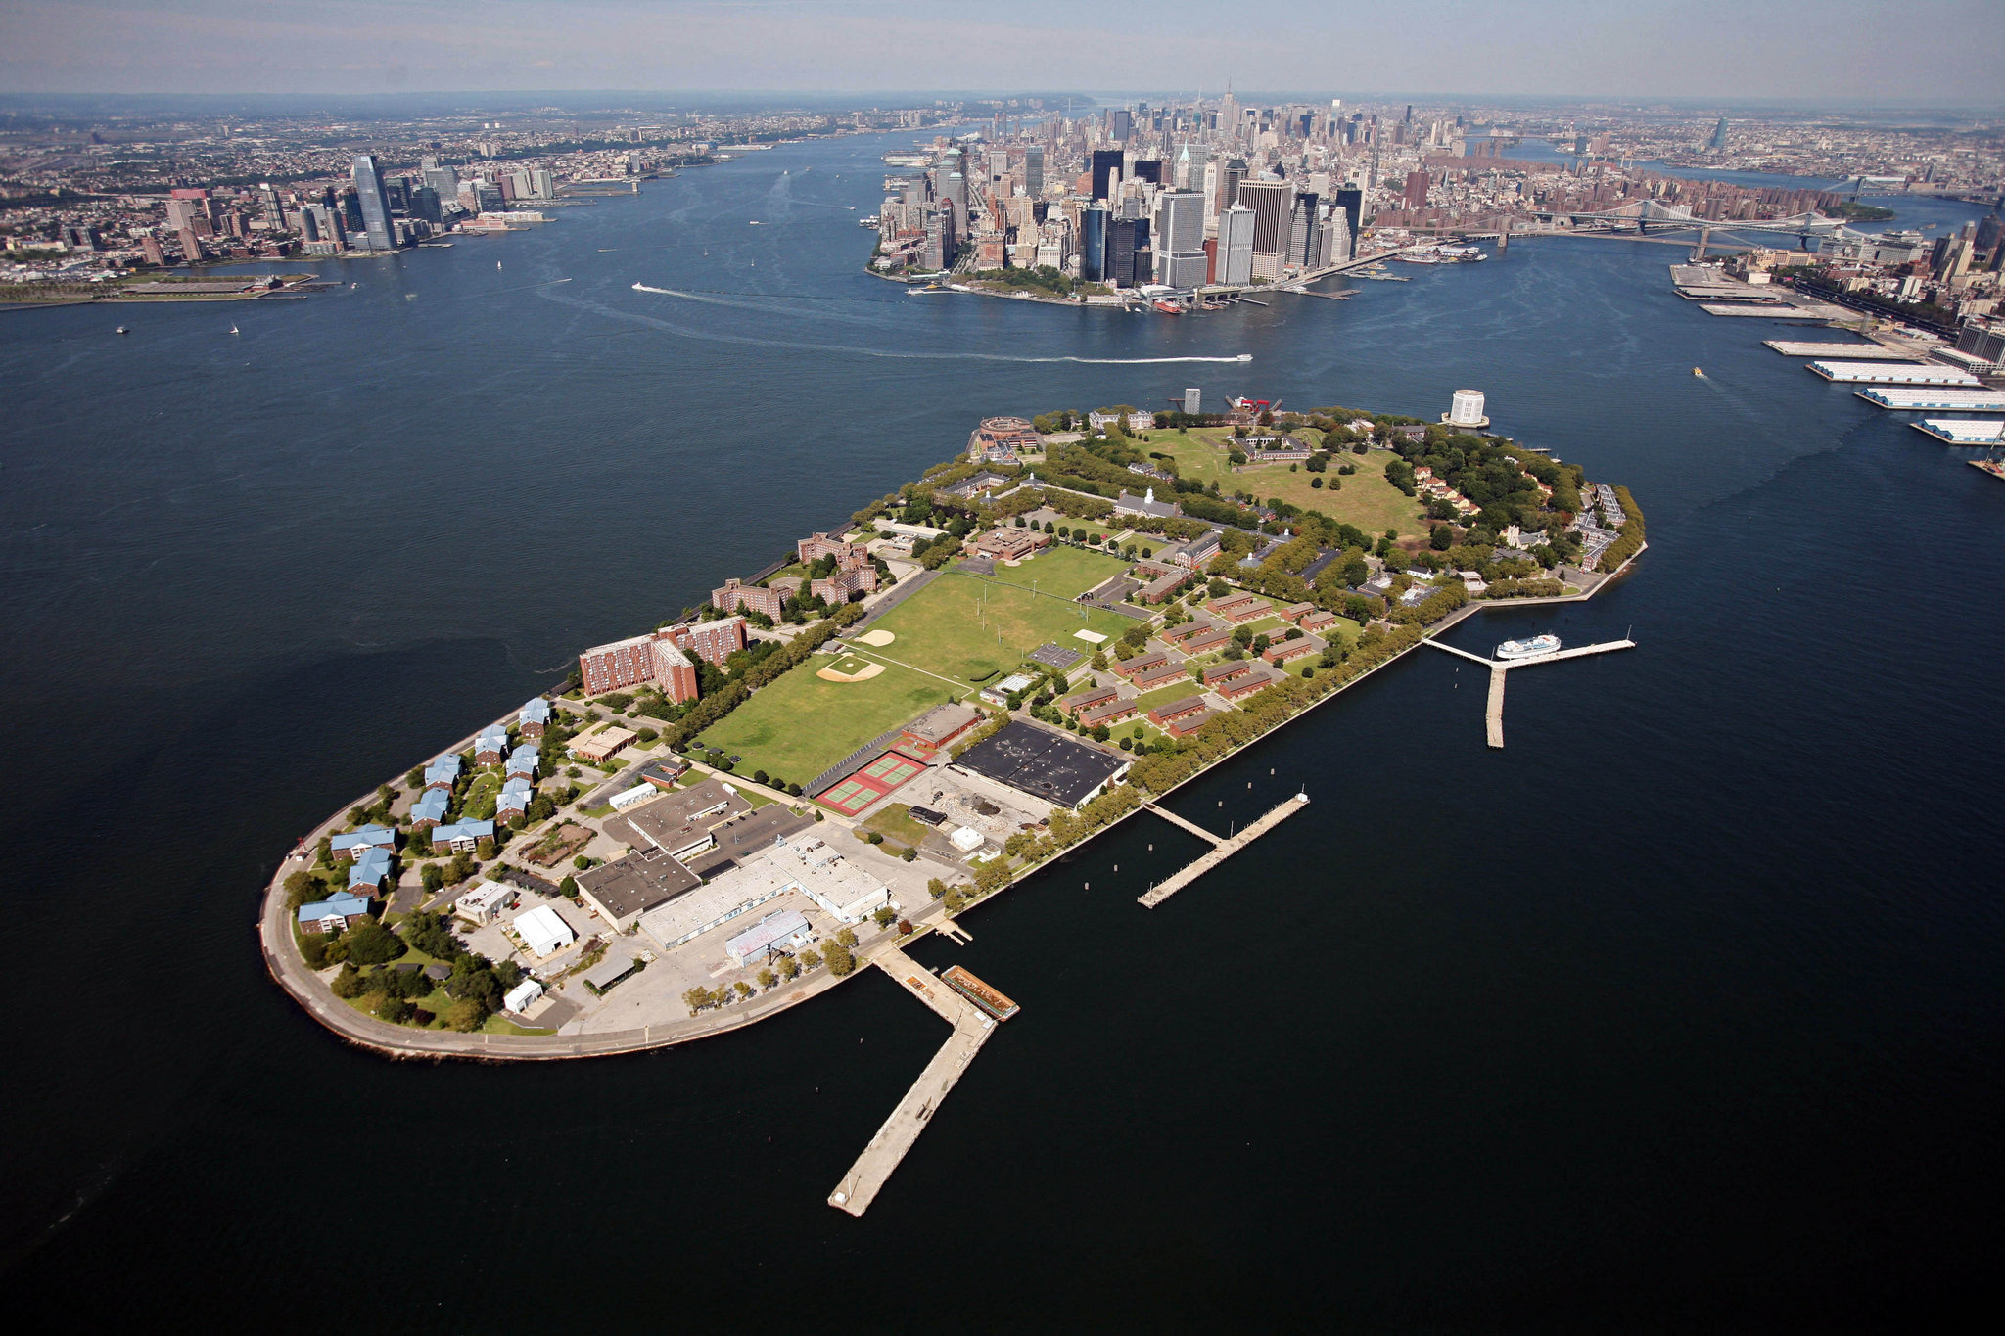
Governor’s Island Proposal
BT-353 Project Management

Slide 2

Project Team
Project Manager: Patrick Murray
Communications Manager: Katie Prescott
Logistics Advisor: Conor Manning
Lead Designer: Nicholas Tang-Mifsud
Financial Advisor: Jason Pagoulatos
Insurance Consultant: Jonathan Schwarz
Chief Engineer: Chris Cosgrove

Slide 3

Executive Summary
Won Managment Consultants, Hoboken, NJ
Founded in 1938 by the Won brothers
Ubiquitous in numerous sectors
Government
Finance
Engineering
Technology
Example photo layout

Slide 4
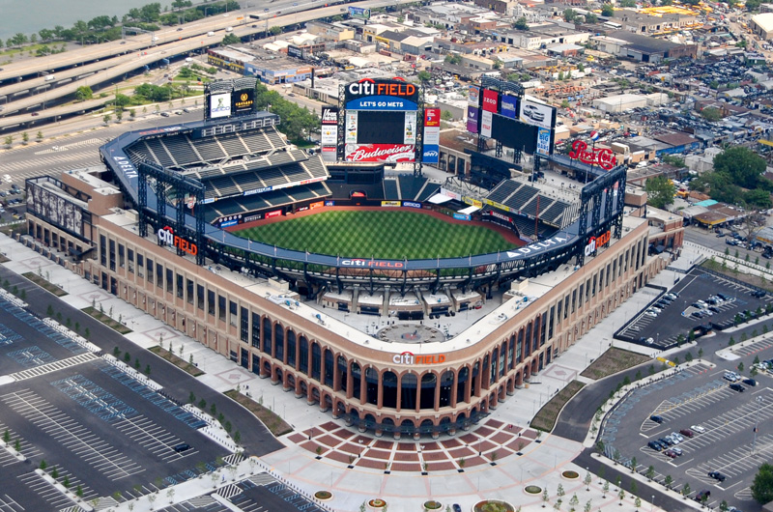
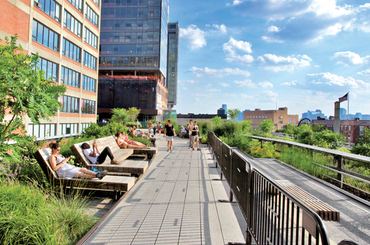
Professional Experience
Example photo layout
Citi Field
Yankee Stadium
The High Line
Brooklyn Bridge Park

Slide 5
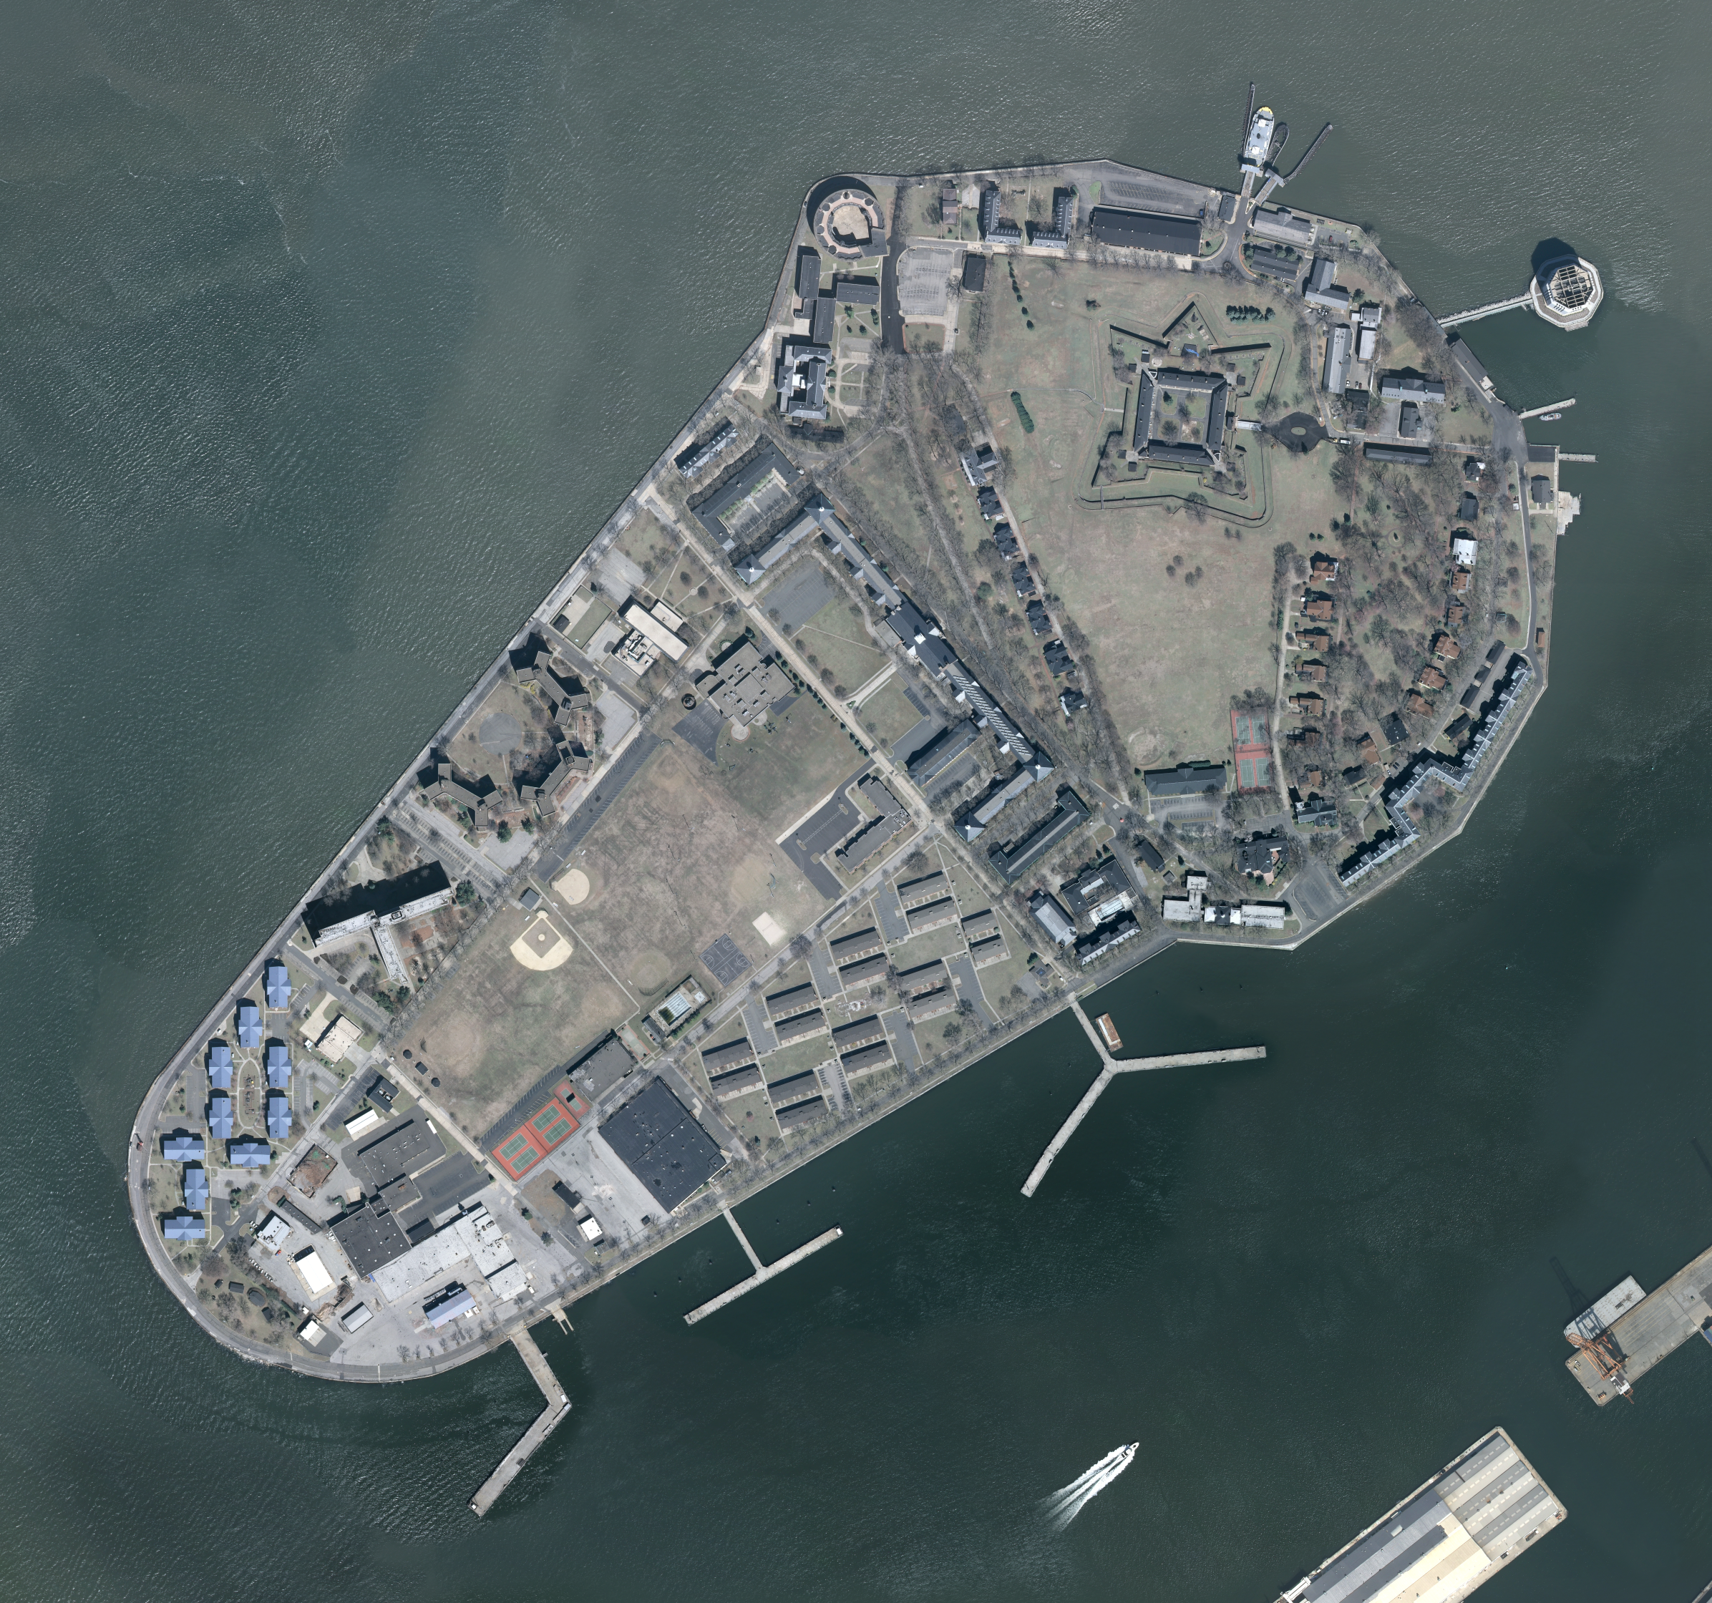
Site Analysis
172 acres
800 yards from Manhattan
400 yards from Brooklyn
Accessible by ferry
Example photo layout

Slide 6
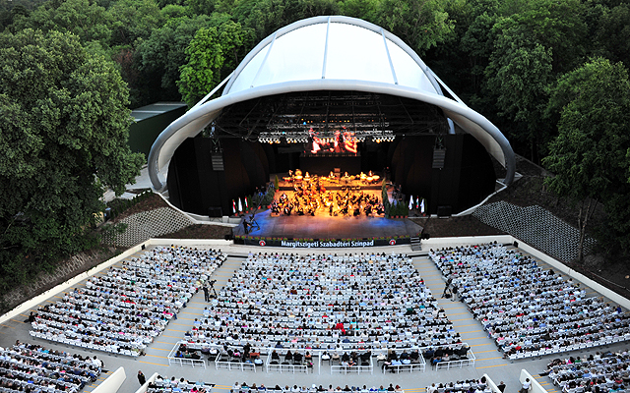
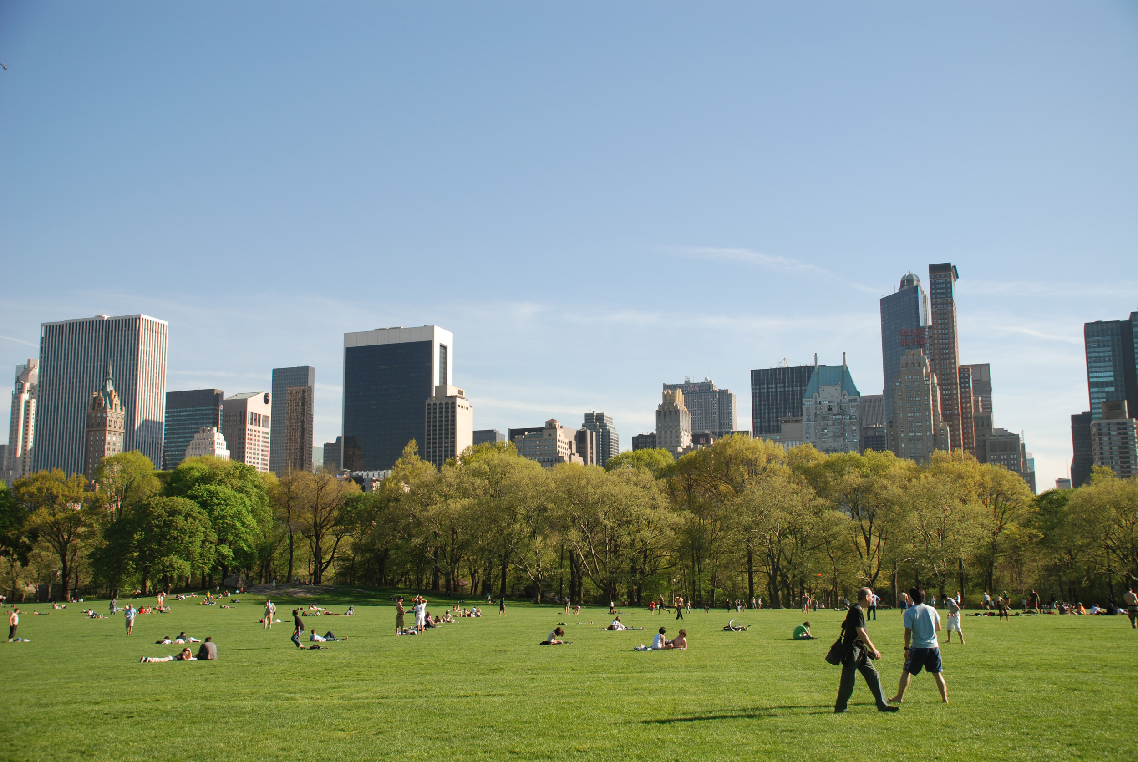
Project Synopsis
Concert Hall
Lawn

Slide 7
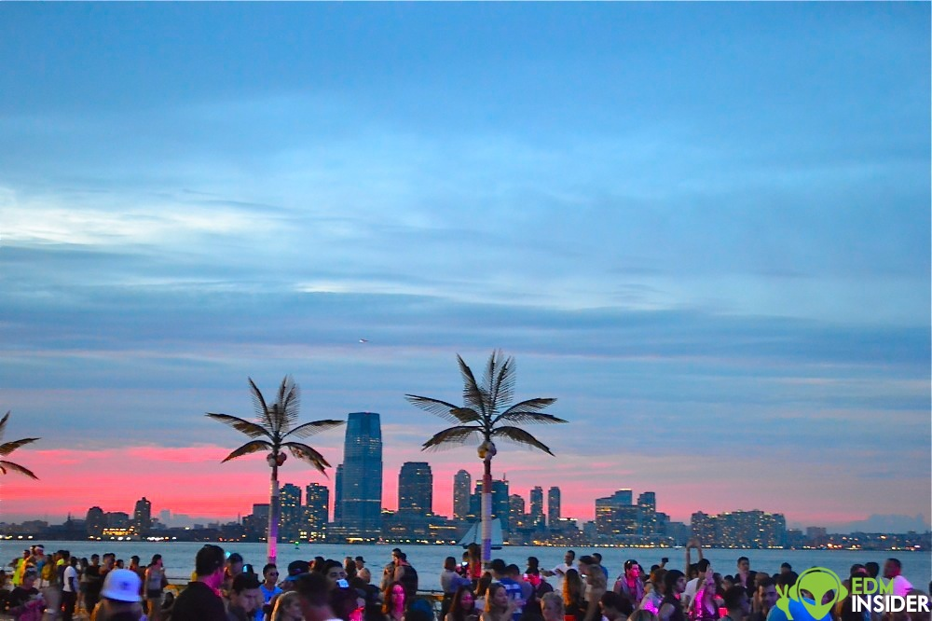
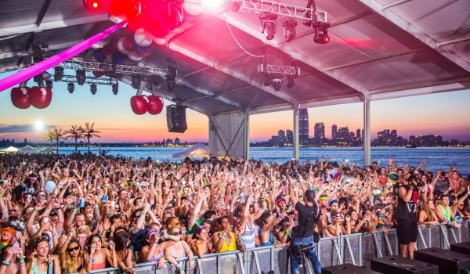
Concert Hall
Already has 20,000 sq. ft. concert hall
Additional dining areas nearby
Separated from lawn area
Discounted tickets for Stevens Students
Example photo layout

Slide 8
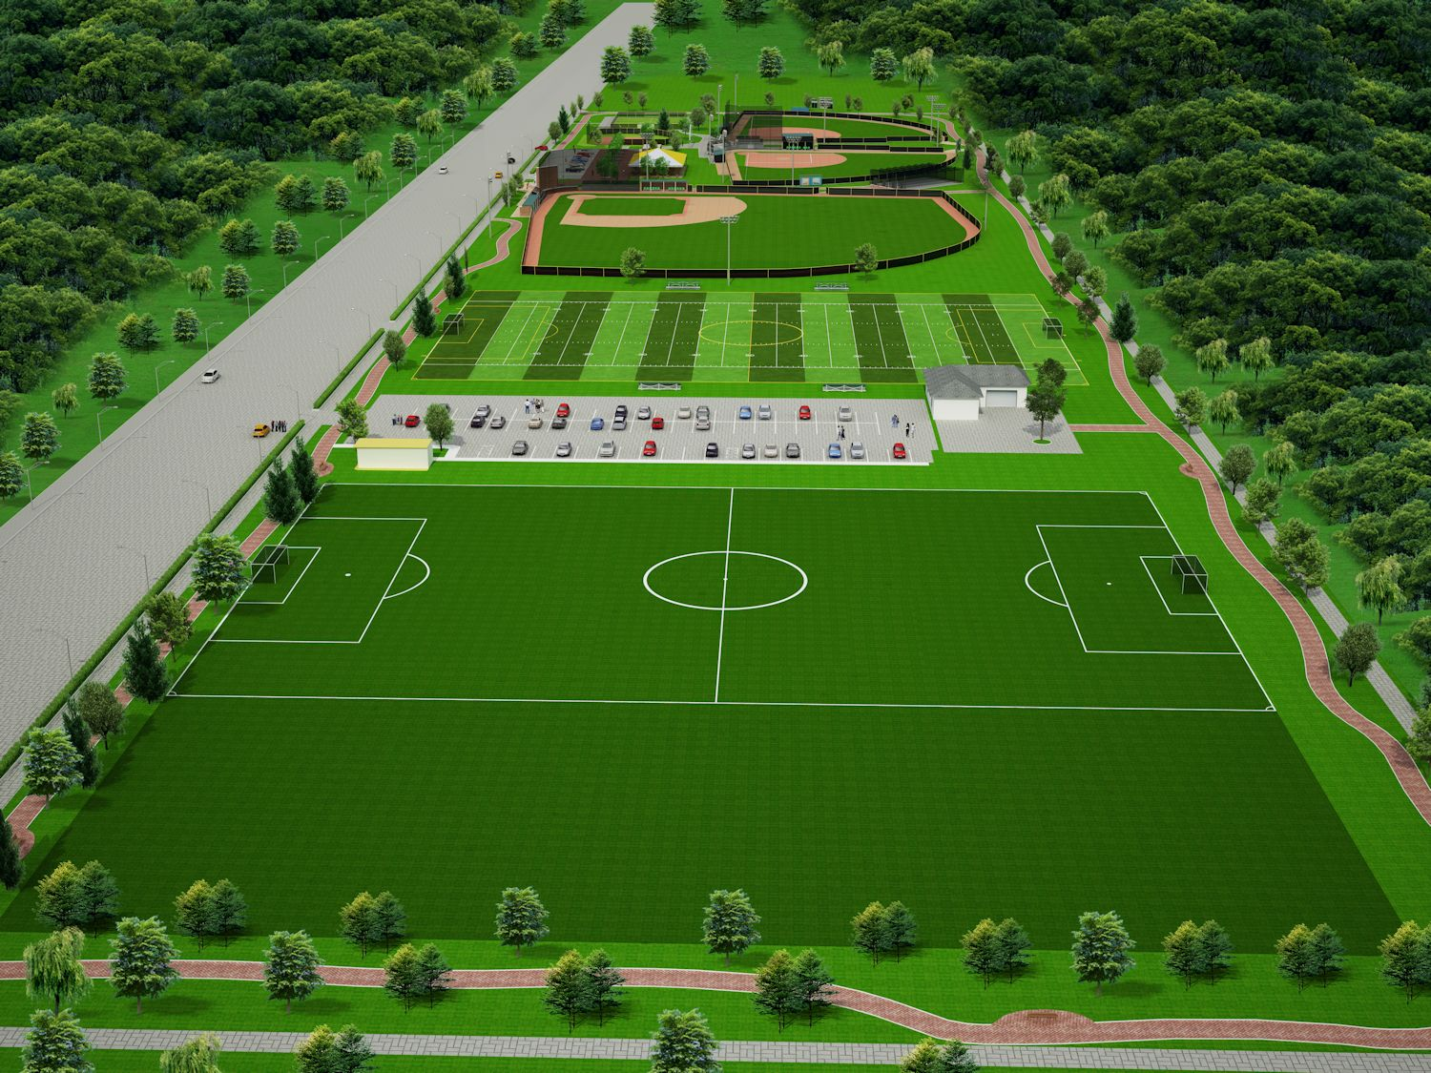
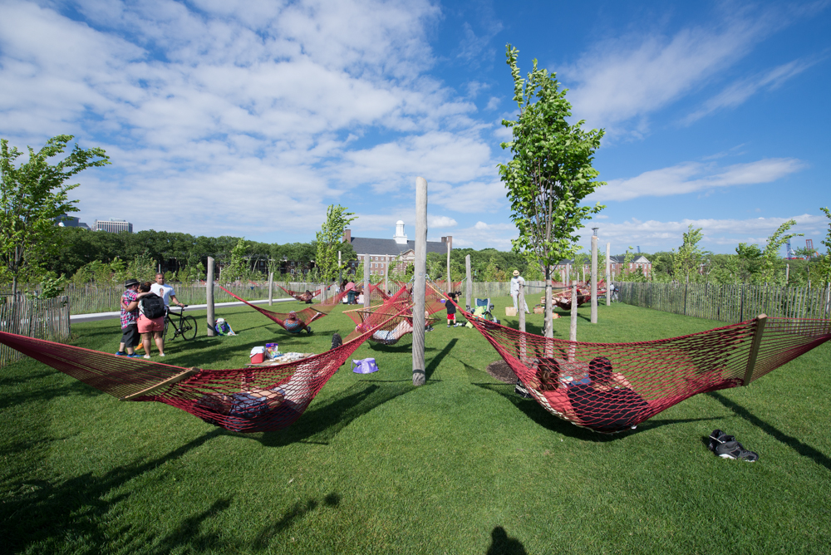
Lawn Breakdown
Sports field
Bike and running trails
Trolley
Docks
Playground
Example photo layout

Slide 9
Expenses
Title | Estimated Expense
Attorney Fees | $1,000,000
Engineering Fees | $1,000,000
Permit Fees | $50,000
Demolition and Excavation Fees | $175,000
Restoration Fees | $5,000,000
Construction | $1,750,000,000
Advertising | $250,000
Architect Fees | $100,000
Equipment Rentals | $500,000
Inspection Fees | $100,000
Landscaping | $7,000,000
Consulting Fees | $1,000,000
Utilities | $1,000,000
Labor | $350,000,000
Total | $2,117,175,000
Example photo layout

Slide 10
Major Milestones
Proposal Submission - September 22, 2015
Finalize Finances - October 13, 2015
Design Completion - December 10, 2015
Community Presentation - December 15, 2015
Groundbreaking - March 1, 2016
Initial Inspections - March 30, 2016
Foundation Complete - July 1, 2016
External Building Construction Complete - August 1, 2017
Build & Landscape Completion - October 1, 2017
Final Inspections - October 2 - 14, 2017
Ribbon Cutting & Stakeholder Tour - October 15,2017
Example photo layout

Slide 11
Thank you
Any Questions?

